Slide 1
PLEASE CLICK TO START THE PRESENTATION

Slide 2
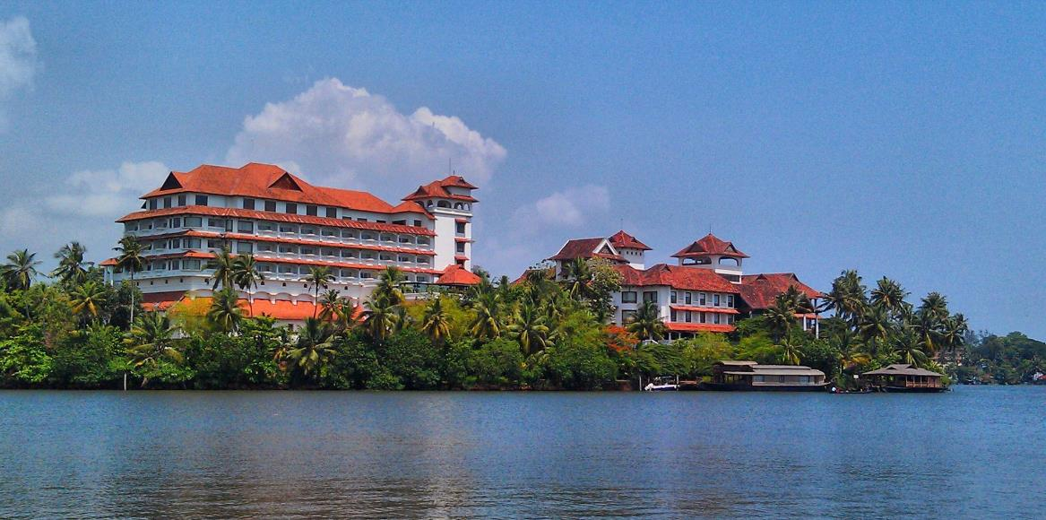

RAVIZ HOTELS & RESORTS
LOYALTY CARD MANAGEMENT PROJECT
We Engineer your
PRESENTED BY PRASHANT THOMAS SOLUTION ARCHITECT
Digital Success

Slide 3

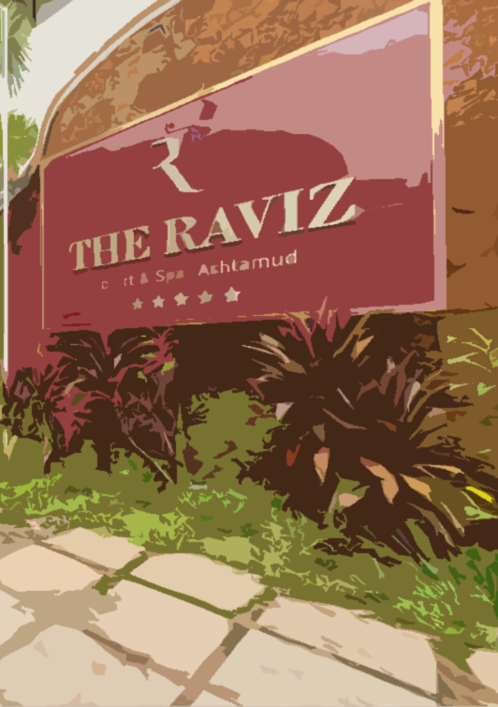
The core objective is to develop a web and mobile application software to frontend the RavizPriviliz line of rewards card. The application shall provide the following key functionalities on a turn key basis
A more personalized experience for Reward card owners
Interactive card based options for front desk operations
Analytics for Management on card use and characteristics
Back office functions for card management & promotions
Our solution incorporates future proofing the application to support
Integration with CRM & ERP applications
Integration with in App map and navigation
Integration for Digital check-ins
Product promotions, campaigns & cross selling
OBJECTIVE
Let’s walk through the process…

Slide 4
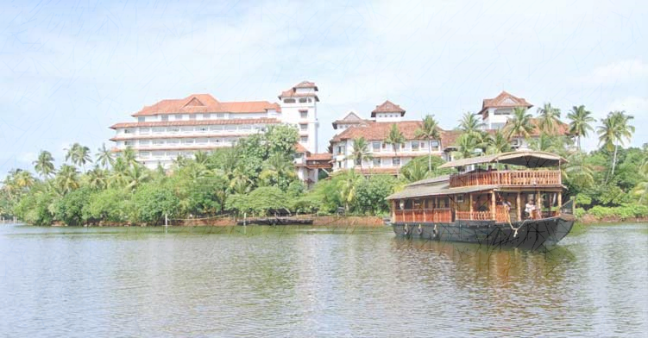
CURRENT SYSTEM

Slide 5


Slide 6
PROPOSED SYSTEM

Slide 7
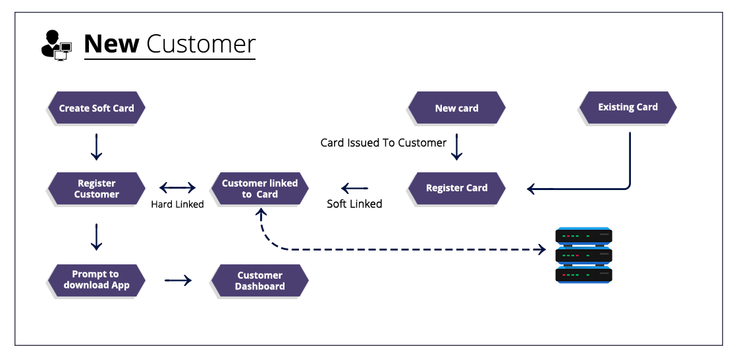

Slide 8
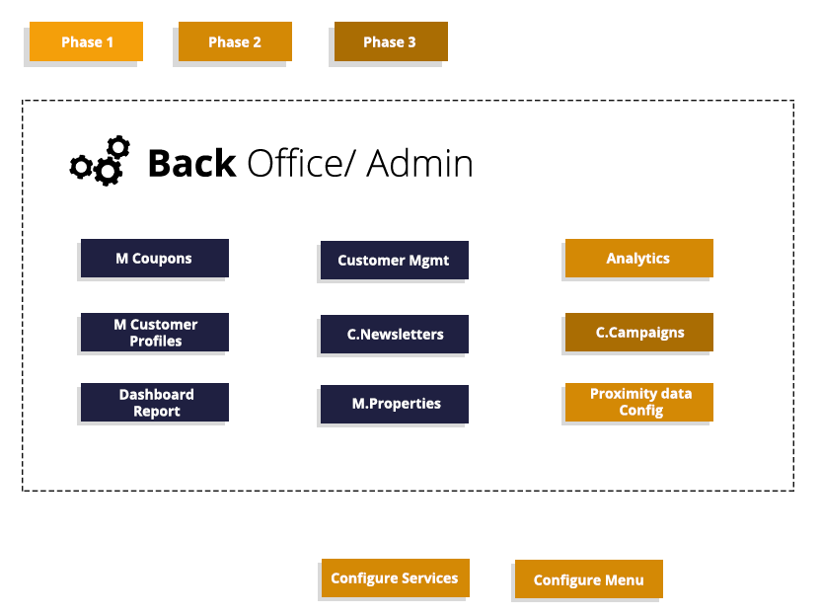

Slide 9
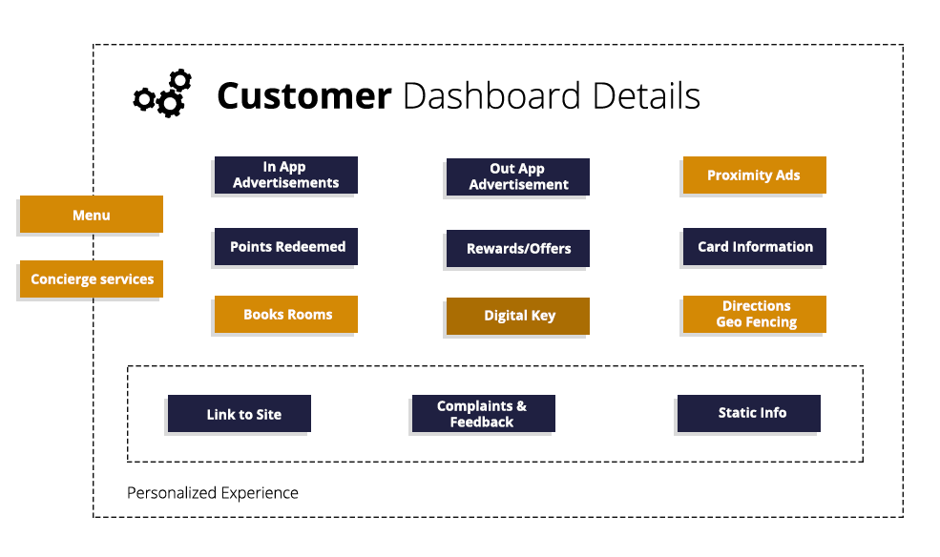

Slide 10
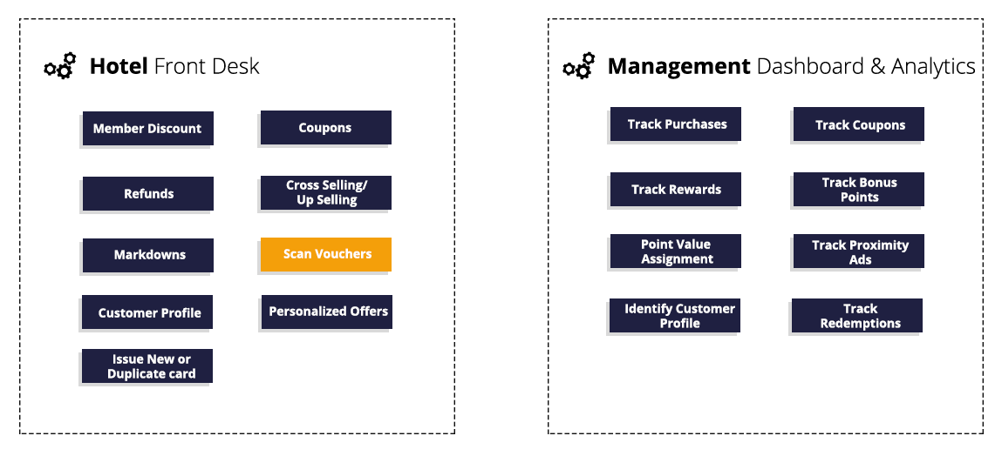

Slide 11
PROCESS FLOW

Slide 12
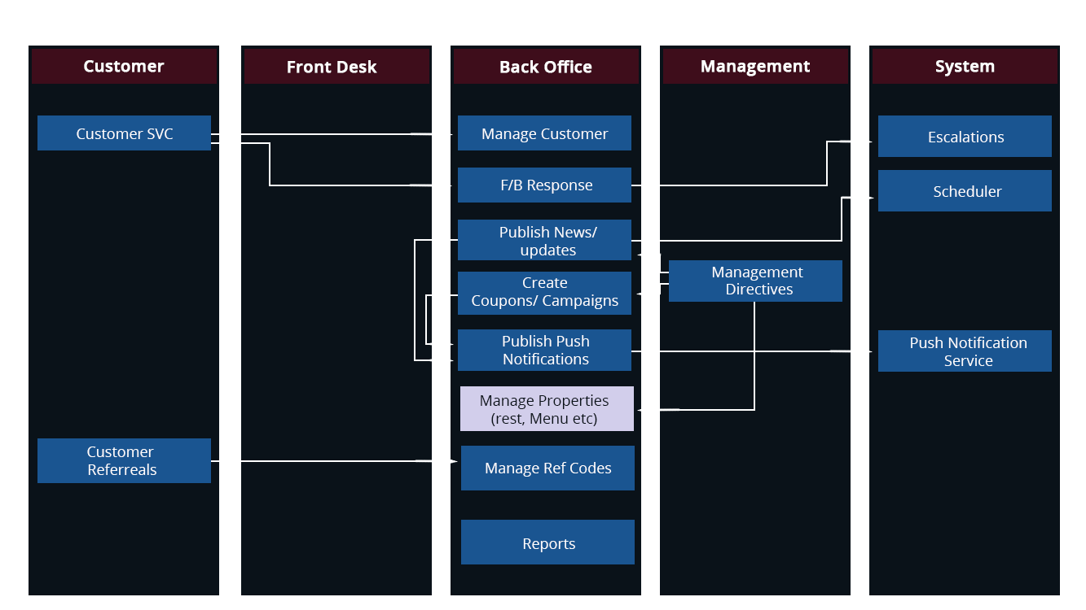

Slide 13
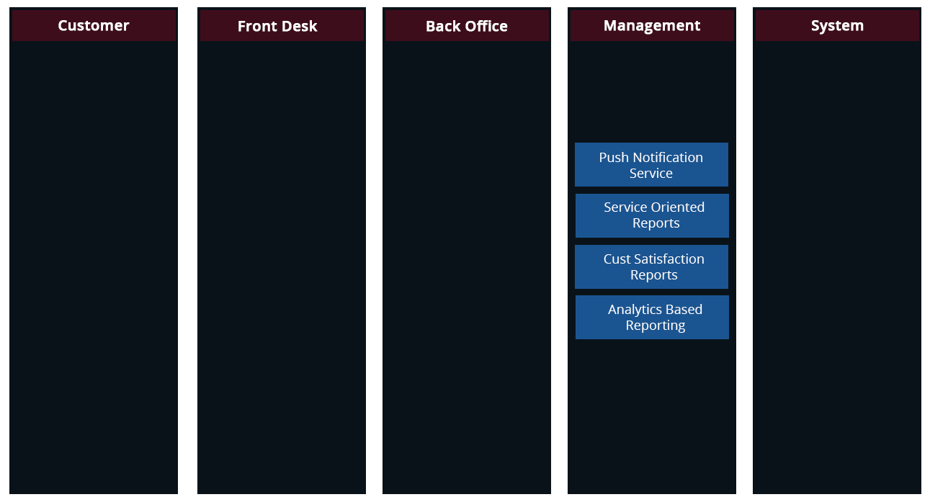

Slide 14
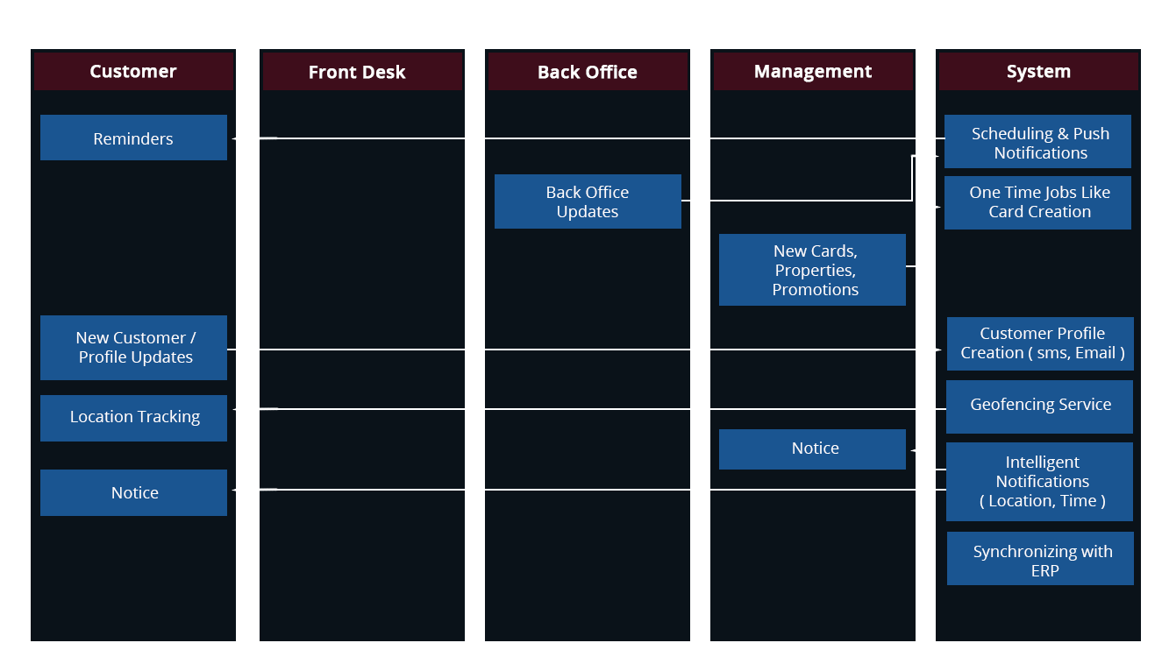

Slide 15
SOFTWARE ARCHITECTURE

Slide 16
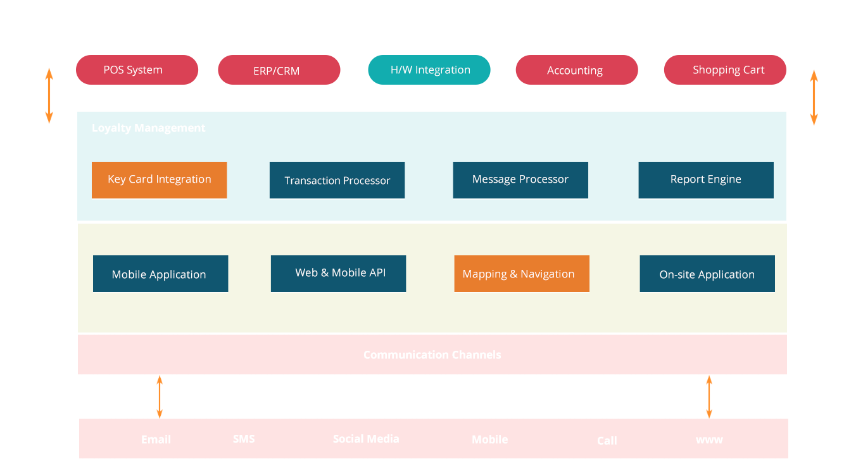

Slide 17
HARDWARE ARCHITECTURE

Slide 18
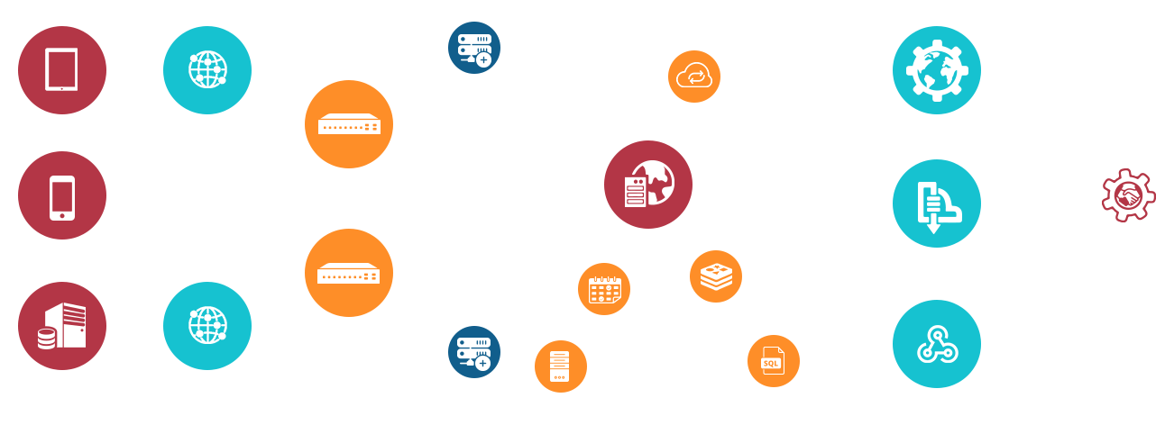

Slide 19



Thank You
India Level 3, PTC Tower
Trivandrum, Kerala
USA 2033 Gateway Place
Suite 500
San Jose , CA- 95110
© 2017. All Rights Reserved | Verbat Technologies | www.verbat.com

